Slide 1
STRATEGIC MARKETING
Lecture 1: Creating Customer Value
Prof. Mohammed Rafiq
Professor of Marketing

Slide 2
QR Codes and Attendance
To register your attendance for the online lecture you must Scan the QR code Shared in the Lecture or Chat by 09:15/ 1015.
Between 9.16-9.30/ 1016-10.30 another/ different QR code will be Shared. Students scanning this code will be marked as LATE.
After 9.30/10.30 the QR code will not work and you will be marked as ABSENT
There are separate codes for the 9-10 and 10-11.00 Lectures.

Slide 3
Some Essentials
The LTAF
Lectures and Seminars: some expectations
Course Assignments:
Formative assignments (1 pieces of group work)
Summative assignment: 3,500 word assignment

Slide 4
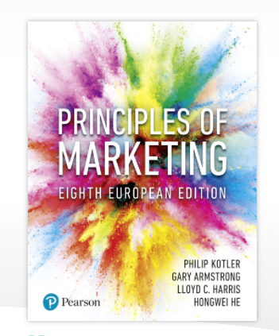
Course Text

Slide 5
Key Aims of the Module
This module aims to provides you with an in-depth, critical understanding of how international companies design and implement marketing strategies to create customer value and competitive advantage in the context of increasingly sophisticated and demanding consumers, the digital revolution and globalisation.
Enable you to apply key marketing concepts and techniques including market orientation, segmentation, targeting and positioning and the marketing mix to real-life situations of international companies operating in the global arena and to put forward and test your own individual, innovative, strategic marketing solutions.

Slide 6
Creating customer value and engagement
Topic outline
What is marketing?
Understand the marketplace and customer needs
Designing a customer-driven marketing strategy
Preparing an integrated marketing plan and programme
Building customer relationships
Capturing value from customers
The changing marketing landscape.

Slide 7
What is marketing?
Marketing is a process by which companies create value for customers and build strong customer relationships to capture value from customers in return.
Notes:
Simply put, Marketing is a process by which companies create value for customers and build strong customer relationships to capture value from customers in return.

Slide 8
The Marketing Process

Slide 9
Understanding the marketplace and customer needs
Customer needs, wants and demands
Needs
Physical—food, clothing, warmth and safety
Social—belonging and affection
Individual—knowledge and self-expression
Wants
Demands
Form that needs take as they are shaped by culture and individual personality
Wants backed by buying power
States of deprivation

Slide 10
Marketing Myopia –HBR Video
https://hbr.org/video/3590615227001/the-explainer-marketing-myopia

Slide 11
The Value of Marketing and the Marketing of Value
Value is benefits received by the consumer from a product relative to total costs.
Marketing activities lead to value creation through innovations that enhance customer benefits and reduce costs.
Marketing promotional activities communicate the value proposition.

Slide 12
Value from the Customer’s Perspective
Customer perspective:
Value is the ratio of perceived benefits to perceived costs.
Value proposition includes the whole bundle of benefits the firm promises to deliver, not just the benefits of the product itself.

Slide 13
Value from the Seller’s Perspective
Value for the seller can take many forms.
What is the economic value of a single customer?
Typically more costly to acquire than to retain
Marketers should look to increase value through co-creation.

Slide 14
Value from Society’s Perspective
Marketing transactions may add or subtract value from society.
Stressing socially responsible and ethical decisions is good for business.
Marketing often faces criticisms.
“Dark side” marketing and consumption issues.

Slide 15
Designing a customer value-driven marketing strategy
Marketing management is the art and science of choosing target markets and building profitable relationships with them.
What customers will we serve?
How can we best serve these customers?

Slide 16
Designing a customer value-driven marketing strategy (Continued)
Marketing management orientations
Production concept
Product concept
Selling concept
Marketing concept
Societal concept

Slide 17
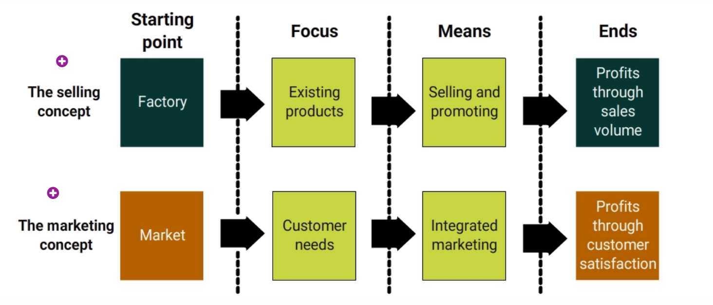
Comparison of Selling and Marketing Concepts

Slide 18
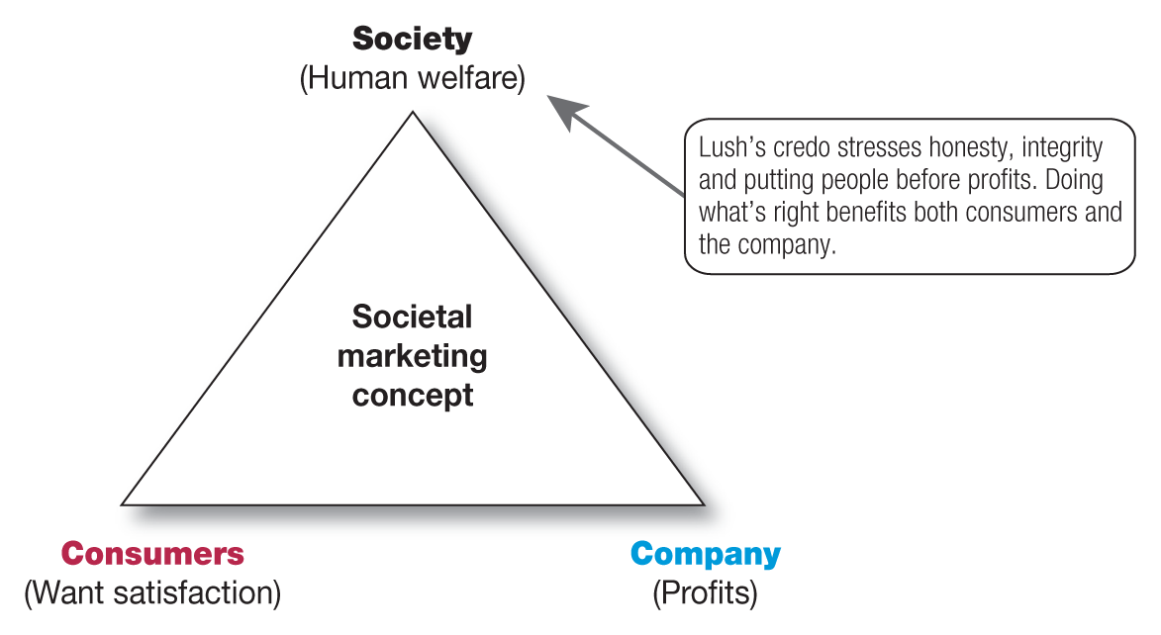
Designing a customer value-driven marketing strategy (Continued)

Slide 19
Building Customer Relationships
Customer Relationship Management
Customer relationship management is the overall process of building and maintaining profitable customer relationships by delivering superior customer value and satisfaction.
1-19

Slide 20
Capturing value from customers
Creating customer loyalty and retention
Customer lifetime value is the value of the entire stream of purchases that the customer would make over a lifetime of patronage.

Slide 21
The changing marketing landscape
Uncertain economic environment
New consumer frugality
Marketers focus on value for the customer

Slide 22
The changing marketing landscape (Continued)
Digital age
People are connected continuously to people and information worldwide.
Marketers have great new tools to communicate with customers.
Internet + mobile communication devices create environment for online marketing.

Slide 23

The Changing Marketing Landscape
Rapid globalization
Sustainable marketing
Not-for-profit marketing growth
1-23

Slide 24
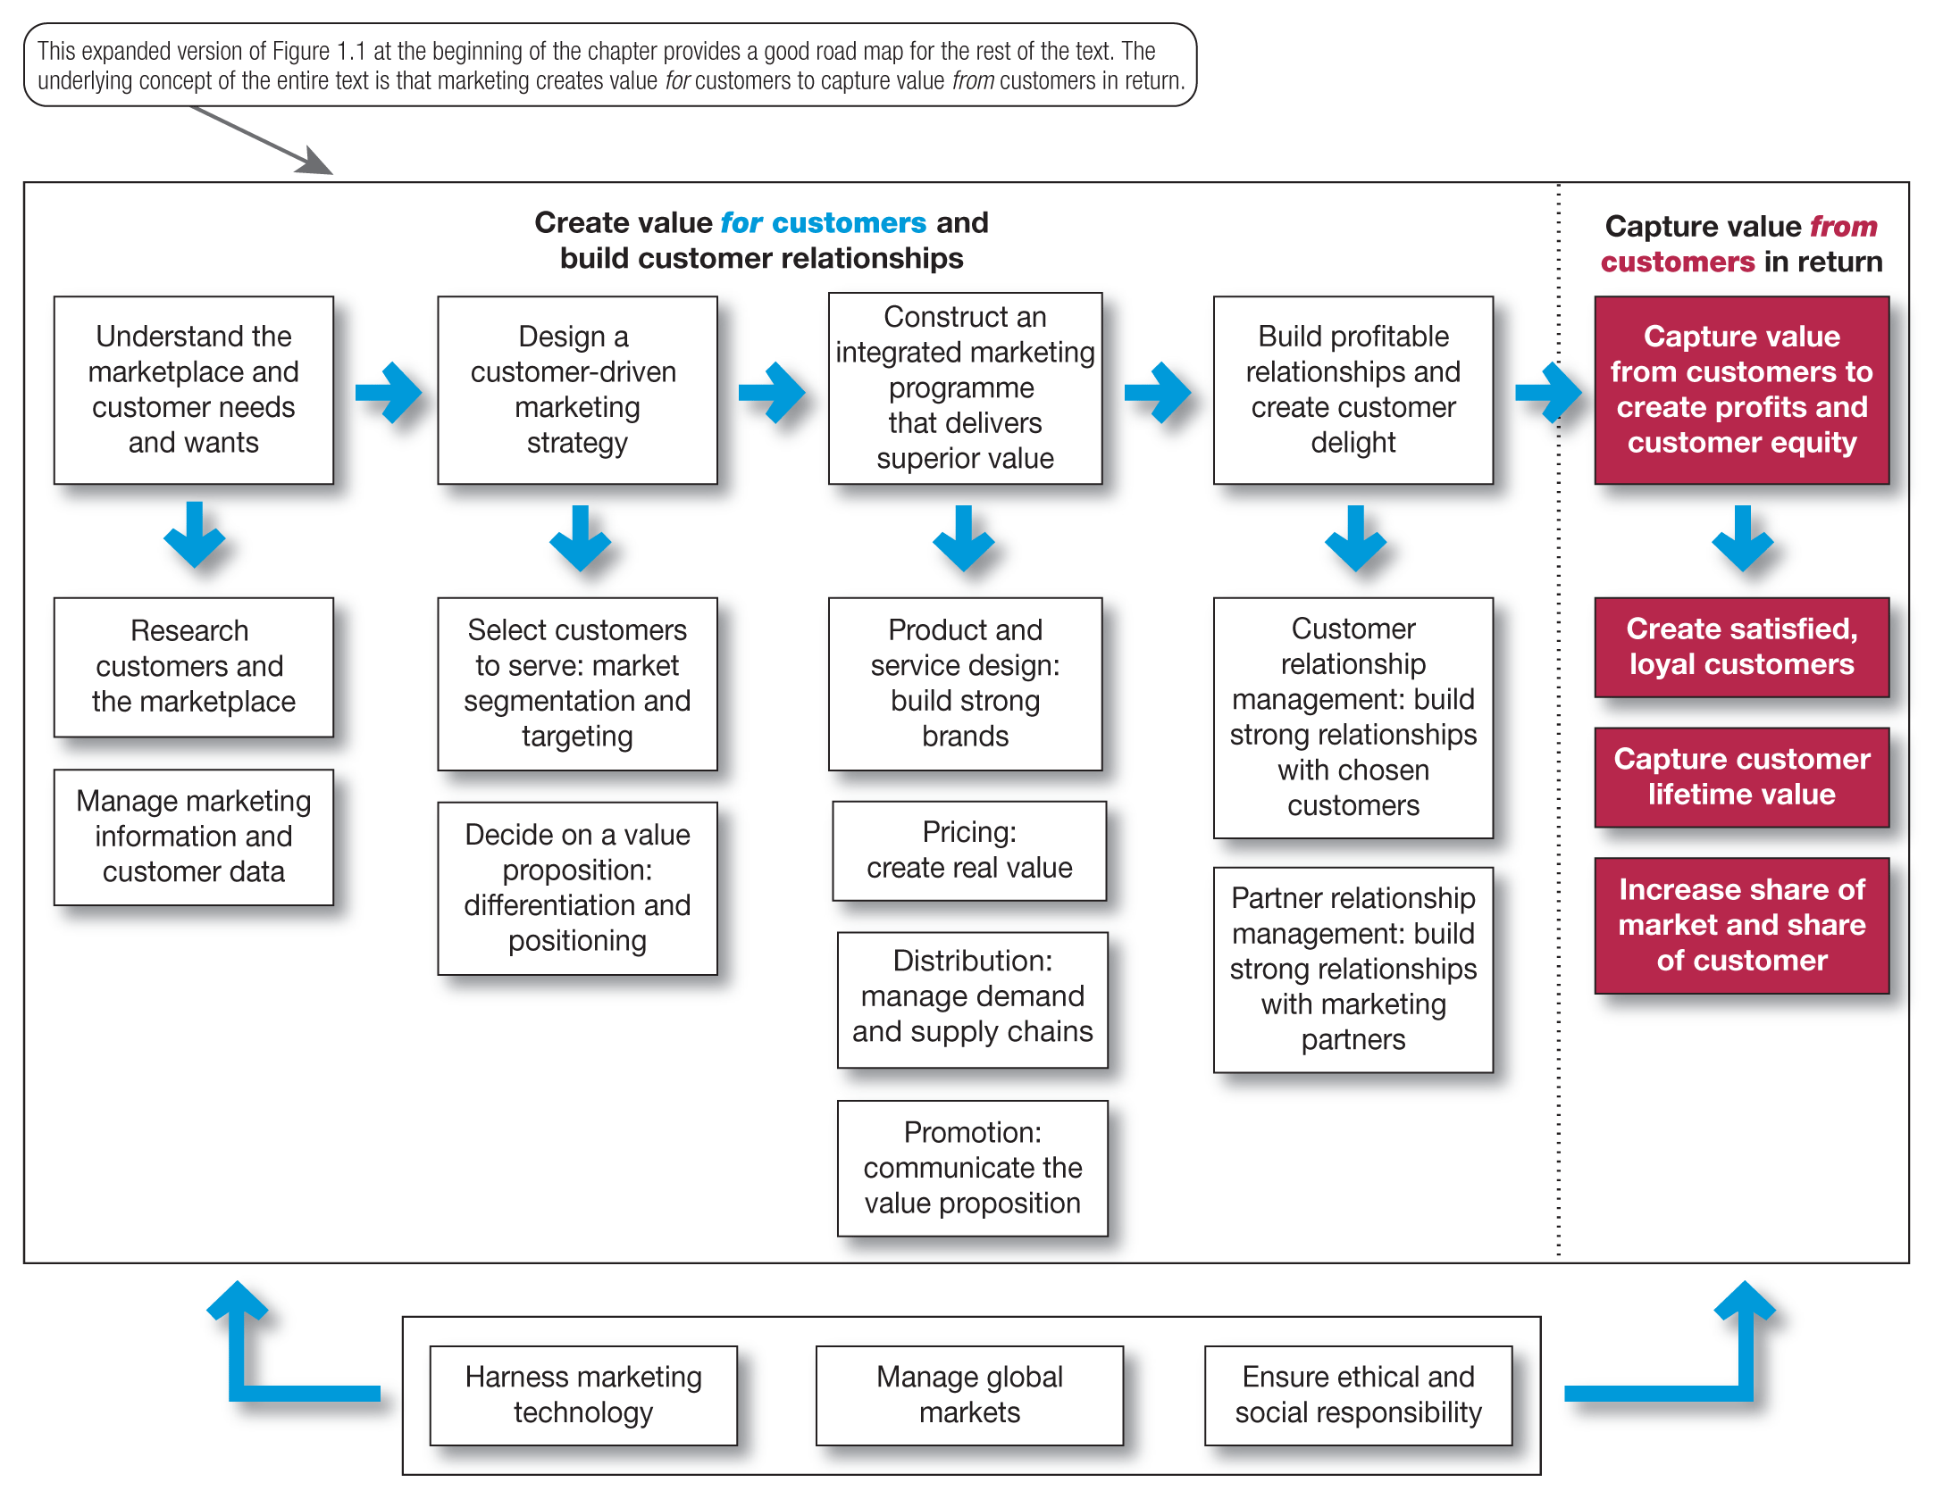
So, what is marketing? Pulling it all together

